Slide 1
Introduction to Programming
Fundamentals

Slide 2
Learning Outcomes
To be able to use Anaconda Prompt Window to execute a Python script
To be able to use Notepad++ to edit Python scripts
To be able to use Jupyter Notebook to write and execute Python code
To understand what variables are and how to use memory state diagram to illustrate variable assignment
To understand int, float and str, and to use them correctly to store different types of data
To understand and be able to efficiently use arithmetic operators
To get familiar with some built-in functions
To understand how to use type conversion functions
To remember the variable naming rules and conventions

Slide 3
Installation
Anaconda
Notepad++

Slide 4
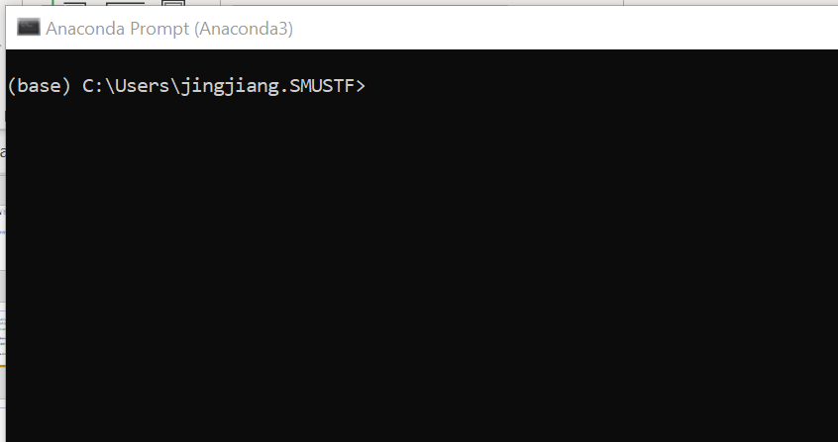
Anaconda Prompt
Search for “Anaconda Prompt” in Windows search. You’ll find “Anaconda Prompt (Anaconda3)”. Click on it.
You’ll see the following window open.

Slide 5
Basic DOS Commands
Command | Explanation
cd <directory> | Enter a subdirectory
cd .. | Enter the parent directory
dir (ls for Mac OS) | List the content of the current directory
cls (clear for Mac OS) | Clear the console window
mkdir | Create a directory

Slide 6
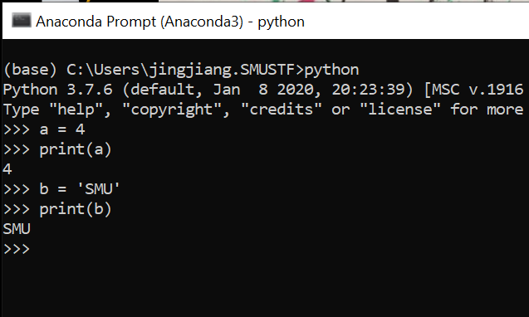
Python Interactive Mode

Slide 7
What Is a Computer Program?
Step-by-step instructions written by humans (programmers) for computers to execute

Slide 8
Python Scripts
A Python script is a text file that contains multiple lines of code (instructions).
A Python script can be directly executed.
C:\Users\jingjiang\IS111\Week1> python hello_world.py

Slide 9
Your Turn
Under C:\Users\<your_username>\, create a directory called “IS111”.
Inside this “IS111” directory, create a directory called “Week1”.
Download the file “hello_world.py” from eLearn into “C:\Users\<your_username>\IS111\Week1\”.
Run this Python script from Anaconda Prompt window.
Open “hello_world.py” in Notepad++. Add two more print statements with any messages you like.
Run “hello_world.py” again to see if you get the expected output.

Slide 10
Jupyter Notebook
“The Jupyter Notebook is an open-source web application that allows you to create and share documents that contain live code, equations, visualizations and explanatory text.” (http://jupyter.org/)
Demo of Jupyter Notebook

Slide 11
Variables
Used to store values.
a = 5
print(a)
b = a + 3
print(b)

Slide 12
Assignment Operator
Assigns the value on the right-hand side to the variable on the left-hand side.
a = 5
print(a)
a = 8
print(a)
a = "SMU"
print(a)

Slide 13
Numbers and Strings
int : whole numbers
e.g., 5, 10, 250
float : decimal numbers
e.g., 2.4, 3.0, 123.8
str : a piece of text
e.g., 'hello', 'Good morning!'

Slide 14
Strings
Typically we place a string inside a pair of single quotes (e.g., 'abc') or a pair of double quotes (e.g., "abc")
The following are also valid strings:
Empty string ('' or "")
A single character (e.g., 'a', ' ')

Slide 15
Lists
A variable can also store a list of values.
a = [2, 4, 6, 8]
print(a)
b = ["A", "B", "C"]
print(b)
c = []
print(c)

Slide 16
Arithmetic Operators
Operator | Description
+ | addition
- | subtraction
* | multiplication
/ | division
% | modulo
// | floor division
** | exponent

Slide 17
Examples
a = 2
b = 9
a + b
b – a
a * b
b / a
b % a
b // a
b ** a

Slide 18
String Concatenation
a = "SMU"
b = "SIS"
c = a + b
print(c)

Slide 19
Precedence
Operator | Description
** | exponent
*, /, %, // | multiplication, division, modulo, floor division
+, - | addition, subtraction
high
low

Slide 20
Associativity
Most are left to right
Exponent is from right to left
What is the value of 2 ** 2 ** 3 ?
To avoid confusion, use brackets
2 ** (2 ** 3)

Slide 21
Built-in Functions
print(3)
print("SMU")
type(3)
type("SMU")

Slide 22
Built-in Functions
min(1, -10, 300)
max(3, 10, 100)
len("SMU")

Slide 23
Built-in Functions
name = input("What's your name? ")

Slide 24
Type Conversion
int(x): convert x into an int
float(x): convert x into a float
str(x): convert x into a str

Slide 25
Rules for Python Variable Names
Python keywords cannot be used as variable names.
A variable name cannot contain any space.
The first character of a variable name must be a letter or an underscore character (_), and the remaining characters must be a letter, a digit, or an underscore character.

Slide 26
Keyword List
https://docs.python.org/3/reference/lexical_analysis.html#keywords

Slide 27
Naming Conventions for Variables
A variable name should be meaningful and represent what it stores. Usually, variable names are nouns.
Use lowercase letters to name variables. If a variable name contains multiple words, use underscore characters to join the words.
home_address
first_name

Slide 28
Review of Learning Outcomes
To be able to use Anaconda Prompt Window to execute a Python script
To be able to use Notepad++ to edit Python scripts
To be able to use Jupyter Notebook to write and execute Python code
To understand what variables are
To understand int, float and str, and to use them correctly to store different types of data
To understand and be able to efficiently use arithmetic operators
To get familiar with some built-in functions
To understand how to use type conversion functions
To remember the variable naming rules and conventions

